Slide 1

ANALYSIS DATA OF CAMPUS REQUIRMENT
BY SAYAN BANERJEE

Slide 2

GENERAL INFORMATION
Data columns (total 15 columns):
# Column Non-Null Count Dtype
--- ------ -------------- -----
0 sl_no 215 non-null int64
1 gender 215 non-null object
2 ssc_p 215 non-null float64
3 ssc_b 215 non-null object
4 hsc_p 215 non-null float64
5 hsc_b 215 non-null object
6 hsc_s 215 non-null object
7 degree_p 215 non-null float64
8 degree_t 215 non-null object
9 workex 215 non-null object
10 etest_p 215 non-null float64
11 specialisation 215 non-null object
12 mba_p 215 non-null float64
13 status 215 non-null object
14 salary 148 non-null float64
THIS DATA SET HAS 15 COLUMNS AND 215 ROWS.
THIS DATA SET HAS NO NULL VALUE .
THE COLLUMNS ARE:
'sl_no', 'gender', 'ssc_p', 'ssc_b', 'hsc_p', 'hsc_b', 'hsc_s','degree_p', 'degree_t', 'workex', 'etest_p', 'specialisation', 'mba_p', 'status', 'salary’

Slide 3
Plcement Status & gender
status
Not Placed 67
Placed 148
Gender
Female 76
Male 139

Slide 4
Count of status on gender Not Placed 67 F 28 M 39 Placed 148 F 48 M 100

Slide 5
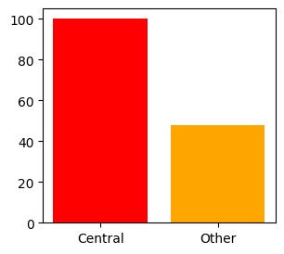
ssc_b Central 116 Others 99

Slide 6
Count of ssc_b on gender and place status Central 116 F 42 Not Placed 17 Placed 25 M 74 Not Placed 21 Placed 53 Others 99 F 34 Not Placed 11 Placed 23 M 65 Not Placed 18 Placed 47

Slide 7
hsc_b Others 131 Central 84

Slide 8
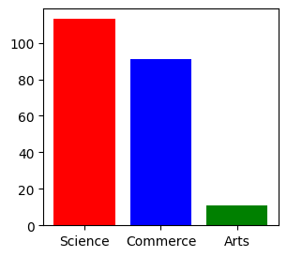
hsc_s Commerce 113 Science 91 Arts 11

Slide 9
Row Labels | Count of hsc_b
Central | 84
F | 33
Not Placed | 13
Placed | 20
M | 51
Not Placed | 14
Placed | 37
Others | 131
F | 43
Not Placed | 15
Placed | 28
M | 88
Not Placed | 25
Placed | 63

Slide 10
Row Labels | Count of hsc_s
Arts | 11
Not Placed | 5
Placed | 6
Commerce | 113
Not Placed | 34
Placed | 79
Science | 91
Not Placed | 28
Placed | 63
Grand Total | 215

Slide 11
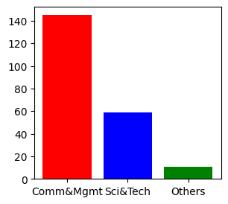
degree_t Comm&Mgmt 145 Sci&Tech 59 Others 11

Slide 12
Row Labels | Count of degree_t
Comm&Mgmt | 145
F | 53
Not Placed | 20
Placed | 33
M | 92
Not Placed | 23
Placed | 69
Others | 11
F | 6
Not Placed | 2
Placed | 4
M | 5
Not Placed | 4
Placed | 1
Sci&Tech | 59
F | 17
Not Placed | 6
Placed | 11
M | 42
Not Placed | 12
Placed | 30

Slide 13
Result analysis
Average of ssc_p | Max. of ssc_p2 | Min. of ssc_p
67.30339535 | 89.4 | 40.89
Average of hsc_p | Max. of hsc_p2 | Min. of hsc_p3
66.33316279 | 97.7 | 37
Average of degree_p | Max. of degree_p2 | Min. of degree_p3
66.37018605 | 91 | 50
Average of mba_p | Max. of mba_p2 | Min. of mba_p3
62.27818605 | 77.89 | 51.21

Slide 14
WORK EXPERIENCE
Row Labels | Count of workex
No | 141
Yes | 74
Row Labels | Count of workex
No | 141
Not Placed | 57
Placed | 84
Yes | 74
Not Placed | 10
Placed | 64

Slide 15
specialisation
Row Labels | Count of specialisation
Mkt&Fin | 120
Mkt&HR | 95

Slide 16
SALARY
Average of salary | Max. of salary | Min. of salary
288655.4054 | 940000 | 200000

Slide 17
THANK YOU

